Slide 1
MACHINE LEARNING FUNDAMENTALS
Instance-Based vs.
Model-Based Learning
Two completely different ways an algorithm can actually learn — memorize the data, or extract the rule behind it.

Slide 2
THE ANALOGY
Machines learn the same two ways we do
THINK BACK TO SCHOOL
You probably knew two kinds of students. One crammed — memorized facts the night before an exam. The other tried to actually understand the underlying concept, so they could work out any question, not just the ones they'd seen before.
Memorizing
Generalizing
A very simple form of learning: store what you saw, and recall it later. No real understanding required — just recognition.
A deeper form of learning: understand the underlying principle, so you can handle situations you've never directly seen before.
INSTANCE-BASED VS. MODEL-BASED LEARNING
2

Slide 3
THE BIG PICTURE
Two families of machine learning algorithms
Instance-Based Learning
Model-Based Learning
a.k.a. “lazy learning”
extracts the underlying rule
Stores the training data as-is. When a new point shows up, it compares that point against everything stored and decides on the spot.
Studies the training data once, extracts a general mathematical relationship, and throws the raw data away — the rule is what's kept.
INSTANCE-BASED VS. MODEL-BASED LEARNING
3

Slide 4
01 · INSTANCE-BASED LEARNING
Store everything, decide when asked
DEFINITION
Instance-based learning stores the training data essentially untouched. There's no real “training” step — the algorithm just holds on to the data quietly. When a new query point finally arrives, it compares that point to everything stored and answers immediately.
Store all training
data points
Wait for a new
query point
Measure distance to
every stored point
Answer using the
nearest neighbors
WHY IT'S CALLED “LAZY LEARNING”
During training, this approach does almost nothing — it just files the data away. All the real work happens later, at prediction time, which is why it's nicknamed lazy learning.
INSTANCE-BASED VS. MODEL-BASED LEARNING
4

Slide 5
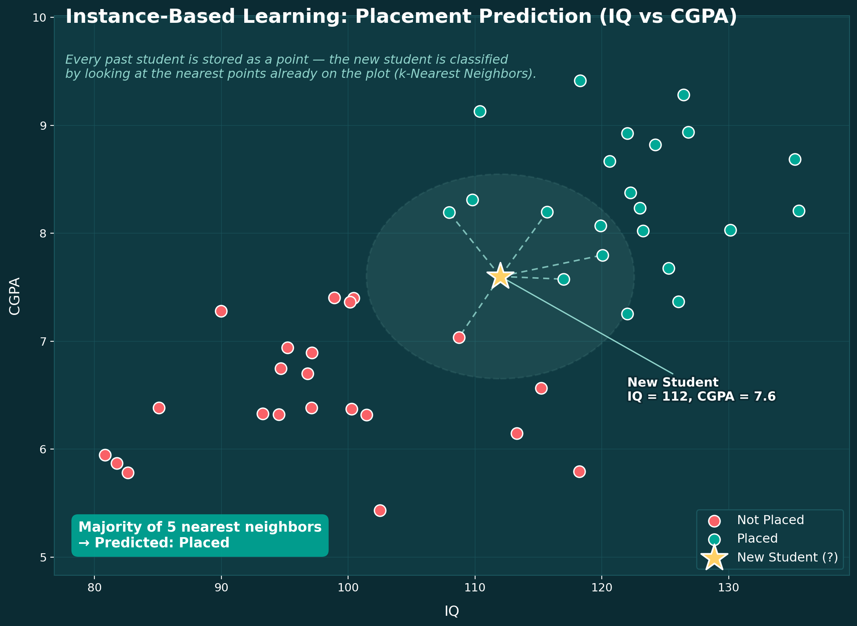
01 · INSTANCE-BASED LEARNING
Worked example: will this student get placed?
The dataset has IQ and CGPA as inputs, and Placement (Yes/No) as the output. Instance-based learning plots every student as a point — red for “not placed,” blue for “placed” — and simply keeps all of them on hand.
When a brand-new student's IQ and CGPA come in, the algorithm doesn't consult any pre-built rule. It looks at where that new point lands relative to everyone already stored.
THE DECISION: NEAREST NEIGHBORS
The algorithm measures the new point's distance to every stored student, then looks at its k closest neighbors — say, the 3 nearest.
If 2 of those 3 nearest students got placed, the new student is predicted “Yes.” The idea: points that sit near each other tend to behave alike. This is the core logic behind k-Nearest Neighbors (KNN).
INSTANCE-BASED VS. MODEL-BASED LEARNING
5

Slide 6
02 · MODEL-BASED LEARNING
Extract the rule, then forget the data
DEFINITION
Model-based learning studies the training data once and tries to extract the underlying mathematical relationship between input and output. The result is a decision function — once that function exists, the raw training data is no longer needed to make predictions.
Feed the algorithm
training data
It searches for an
underlying pattern
It fits a mathematical
decision function
New points get classified
by that function alone
THE GOOD PART
Because the rule is generalized once, in advance, you no longer need to keep the training points around — which is the opposite of instance-based learning.
INSTANCE-BASED VS. MODEL-BASED LEARNING
6

Slide 7
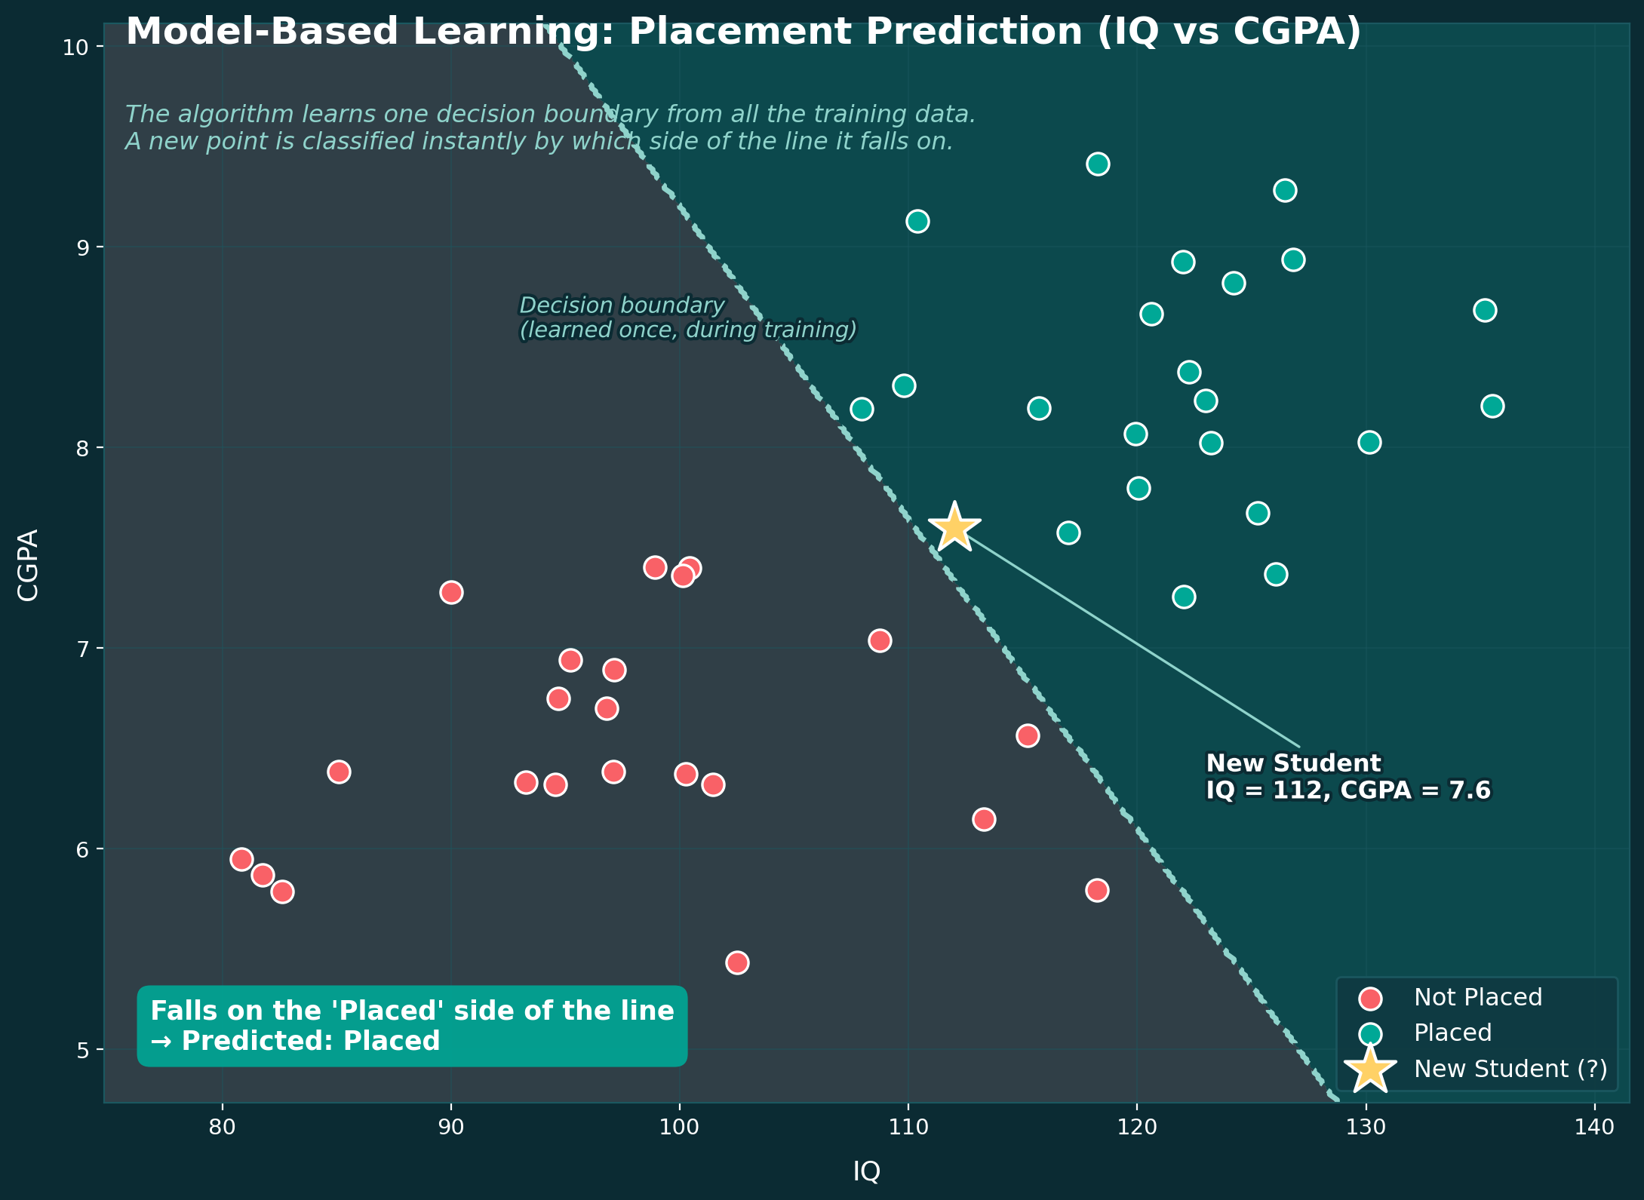
02 · MODEL-BASED LEARNING
Same dataset, a completely different approach
Same IQ, CGPA, and Placement data, plotted the same way — red for “not placed,” blue for “placed.” But this time, the algorithm doesn't wait for a query point to do anything.
THE DECISION: A BOUNDARY LINE
During training, the algorithm draws a decision boundary through the data — a line (or curve) that best separates placed from not-placed students.
Once that boundary exists, classifying any new point is instant: which side of the line does it fall on? No comparison to individual students required — the boundary already encodes the pattern.
INSTANCE-BASED VS. MODEL-BASED LEARNING
7

Slide 8
IN THE WILD
Which common algorithms are which?
Most algorithms you'll encounter are model-based — instance-based learning has a much shorter list.
Instance-Based
Model-Based
k-Nearest Neighbors (KNN)
Linear Regression
Some kernel-based methods
Logistic Regression
Decision Trees
Support Vector Machines
Neural Networks
...and most other ML algorithms
INSTANCE-BASED VS. MODEL-BASED LEARNING
8

Slide 9
PUTTING IT TOGETHER
Instance-based vs. model-based, feature by feature
Instance-Based
Model-Based
Data preparation
Same effort either way — nulls, encoding, etc.
Same effort either way — nulls, encoding, etc.
What training produces
Nothing — data is just stored as-is
A model with learned parameters
Storage required
All training data, forever (grows with data)
Just the small, fitted function
When it “generalizes”
Only when a new query point arrives
Once, during training — before any query
Needs training data later?
Yes — always, for every prediction
No — the rule alone is enough
INSTANCE-BASED VS. MODEL-BASED LEARNING
9

Slide 10
SUMMARY
Key takeaways
1
Two ways to learn
2
Instance-based = lazy learning
Just like students, algorithms either memorize (instance-based) or understand the underlying rule (model-based).
Nothing happens during training — the work is deferred until a new query point actually arrives.
3
Model-based extracts a rule
4
Storage differs a lot
Training produces a decision function or boundary — the raw data can be discarded afterward.
Instance-based must keep all training data forever; model-based only needs the small, fitted rule.
5
Generalization timing differs
6
Know which one you're using
Model-based generalizes once, upfront. Instance-based only “decides” when a new point shows up.
Whenever you learn a new algorithm, ask: is this memorizing, or generalizing?
INSTANCE-BASED VS. MODEL-BASED LEARNING
10

